Slide 1
MDS & CORRESPONDENCE ANALYSIS
Market Research for Samsung
PIETRO RUFFO LUCA RUBERTO OTHMAN AL-AKHALI MARCO TUCCI
ANTONIO DE SARRO

Slide 2
GOALS
Understand how different TV models differ from each other on the basis of price and technical features
Identify certain characteristics of consumers that may be associated with the purchase of a particular category of TV.

Slide 3
METRIC MULTIDIMENSIONAL SCALING
INPUT:
data relating to technical features detected on TV models
THROUGH:
Distance Matrix
OUTPUT:
perceptual map in a small number of dimensions

Slide 4
MDS KEY CONCEPT
Usually: from a geometric configuration to distances
MDS: from distances to a geometric configuration

Slide 5
PRE-ANALYSIS
Data Reading
Sampling Selection
Focus on Variables

Slide 6
VARIABLES
## Screen DCR LCD.Hz NatRes Price ## 31 46 80 120 1080 1899.99 ## 15 32 100 120 1080 1099.99 ## 14 32 80 120 1080 1099.99 ## 3 19 15 60 720 329.99 ## 38 52 150 240 1080 2799.99 ## 25 40 150 240 1080 1899.99 ## 26 46 60 60 1080 1299.99 ## 27 46 60 60 1080 1299.99 ## 32 46 100 120 1080 1999.99 ## 5 22 15 60 720 379.99 ## 19 40 60 60 1080 899.99 ## 33 46 150 240 1080 2299.99 ## 35 52 70 60 1080 1899.99 ## 28 46 70 60 1080 1399.99 ## 9 32 30 60 720 549.99
Screen: display size (Inches)
DCR: dynamic contrast ratio
LCD Hz: refresh rate (Hertz)
Nat Res: display resolution (# of pixel)
Price

Slide 7
ANALYSIS PROCEDURE
Data standardisation;
Distance matrix calculation;
Application of Torgerson's theorem.

Slide 8
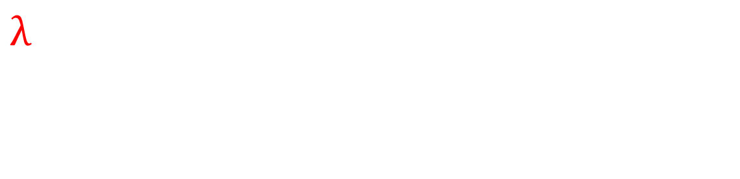
TORGERSON THEOREM’S STEPS
Q matrix computation
Eigenvalues and Eigenvectors extraction
A
[,1] [,2] [,3] [,4] [,5] [1,] 0.117429620 0.12943362 -0.11132331 0.37341057 -0.39828265 [2,] -0.008415682 -0.12039701 0.50446161 0.01109183 0.52924658 [3,] -0.038449286 -0.08080494 0.45625544 0.25982577 -0.24886434 [4,] -0.471401181 -0.28023231 -0.06430627 0.32229131 0.01222005 [5,] 0.435404065 -0.22170226 -0.36867700 0.12299241 -0.05421876 [6,] 0.281339395 -0.40332793 0.18412455 -0.29590093 -0.06353892 [7,] -0.016311048 0.31822684 0.03134239 -0.14589362 -0.22483909 [8,] -0.016311048 0.31822684 0.03134239 -0.14589362 -0.22483909 [9,] 0.157008507 0.09050478 -0.09405970 0.27472627 0.44394500 [10,] -0.449589260 -0.23598653 -0.14835717 0.16442778 -0.09765418 [11,] -0.088570742 0.22774562 0.29227189 -0.28031547 -0.19744081 [12,] 0.353599088 -0.31284671 -0.07680495 -0.16147908 -0.09093720 [13,] 0.090056015 0.39023848 -0.26736914 0.16426054 0.26505154 [14,] 0.008251038 0.29909403 0.02450292 -0.12021095 0.22833310 [15,] -0.354039480 -0.11817255 -0.39340365 -0.54333280 0.12181879
$λ$ [,1] [,2] [,3] [,4] [,5] [1,] 52.53643 0.00000 0.000000 0.0000000 0.0000000 [2,] 0.00000 12.94463 0.000000 0.0000000 0.0000000 [3,] 0.00000 0.00000 3.908478 0.0000000 0.0000000 [4,] 0.00000 0.00000 0.000000 0.4511689 0.0000000 [5,] 0.00000 0.00000 0.000000 0.0000000 0.1593006

Slide 9
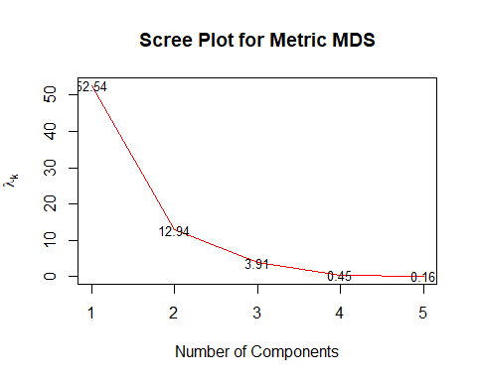
G INDEX & SCREE PLOT
Cumulative G index
## [1] 0.7505204 0.9354436 0.9912790 0.9977243 1.0000000

Slide 10
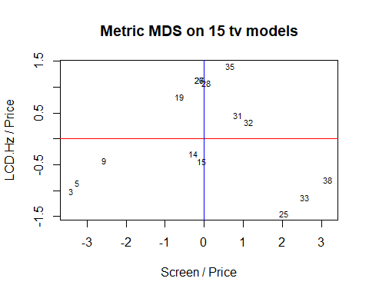
METRIC MDS PLOT
## Screen DCR LCD.Hz NatRes Price x ## 38 52 150 240 1080 2799.99 0.01857149 ## 33 46 150 240 1080 2299.99 0.02000009 ## 25 40 150 240 1080 1899.99 0.02105274 ## 32 46 100 120 1080 1999.99 0.02300012 ## 31 46 80 120 1080 1899.99 0.02421065 ## 35 52 70 60 1080 1899.99 0.02736857 ## 15 32 100 120 1080 1099.99 0.02909117 ## 14 32 80 120 1080 1099.99 0.02909117 ## 28 46 70 60 1080 1399.99 0.03285738 ## 26 46 60 60 1080 1299.99 0.03538489 ## 27 46 60 60 1080 1299.99 0.03538489 ## 19 40 60 60 1080 899.99 0.04444494 ## 3 19 15 60 720 329.99 0.05757750 ## 5 22 15 60 720 379.99 0.05789626 ## 9 32 30 60 720 549.99 0.05818288
## Screen DCR LCD.Hz NatRes Price y ## 35 52 70 60 1080 1899.99 0.03157911 ## 28 46 70 60 1080 1399.99 0.04285745 ## 26 46 60 60 1080 1299.99 0.04615420 ## 27 46 60 60 1080 1299.99 0.04615420 ## 32 46 100 120 1080 1999.99 0.06000030 ## 31 46 80 120 1080 1899.99 0.06315823 ## 19 40 60 60 1080 899.99 0.06666741 ## 38 52 150 240 1080 2799.99 0.08571459 ## 33 46 150 240 1080 2299.99 0.10434828 ## 15 32 100 120 1080 1099.99 0.10909190 ## 14 32 80 120 1080 1099.99 0.10909190 ## 9 32 30 60 720 549.99 0.10909289 ## 25 40 150 240 1080 1899.99 0.12631645 ## 5 22 15 60 720 379.99 0.15789889 ## 3 19 15 60 720 329.99 0.18182369

Slide 11
CORRESPONDENCE ANALYSIS
Input
Contingency table
Rows → Categories
Columns → Characteristics of buyers
Output
Unique graphic representation in a low # of dimensions

Slide 12

Selection of column profiles for the analysis
## Categoria M F Eta<35 Eta35-50 Eta>50 Reddito_alto Reddito.basso ## 31 3 1 3 0 2 3 4 1 ## 15 2 3 4 1 3 1 3 3 ## 14 2 3 3 3 1 1 3 0 ## 3 1 3 2 4 1 1 1 5 ## 38 4 1 4 0 0 5 4 1 ## 25 3 2 4 1 1 1 4 2 ## 26 3 2 4 2 0 1 3 2 ## 27 3 2 1 1 0 1 2 1 ## 32 4 1 1 0 1 4 4 1 ## 5 1 3 2 4 1 1 2 4 ## 19 2 4 2 4 3 1 1 2 ## 33 4 3 3 1 1 4 3 1 ## 35 3 2 3 1 1 1 3 1 ## 28 3 2 3 0 2 2 3 2 ## 9 1 3 2 3 5 0 2 4
Contingency Table(input)
## M F Eta<35 Eta35-50 Eta>50 Reddito_alto Reddito.basso ## 1 9 6 11 7 2 5 13 ## 2 10 9 8 7 3 7 5 ## 3 11 18 5 6 9 19 9 ## 4 5 8 1 2 13 11 3

Slide 13
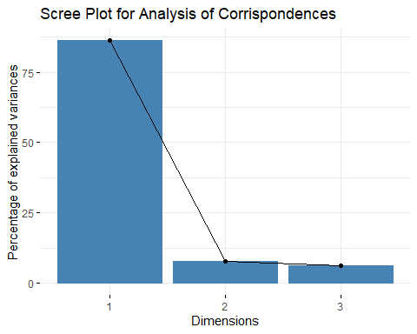
M and F: additional information
Analysis Output
Principal inertias (eigenvalues): 1 2 3 Value 0.229439 0.020282 0.016231 Percentage 86.27% 7.63% 6.1% ## Rows: ## 1 2 3 4 ## Mass 0.260274 0.205479 0.328767 0.205479 ## ChiDist 0.599413 0.393853 0.270042 0.753257 ## Inertia 0.093515 0.031874 0.023975 0.116588 ## Dim. 1 -1.204508 -0.652187 0.404844 1.530147 ## Dim. 2 -0.972958 0.642551 1.093019 -1.158967 ## ## ## Columns: ## M (*) F (*) Eta<35 Eta35-50 Eta>50 Reddito_alto ## Mass NA NA 0.171233 0.150685 0.184932 0.287671 ## ChiDist 0.226031 0.297203 0.609616 0.384881 0.739824 0.382013 ## Inertia NA NA 0.063636 0.022321 0.101220 0.041981 ## Dim. 1 -0.313656 0.327494 -1.245327 -0.712426 1.482256 0.692706 ## Dim. 2 0.781869 1.772179 -0.352772 0.615143 -1.364727 1.279253 ## Reddito.basso ## Mass 0.205479 ## ChiDist 0.423159 ## Inertia 0.036794 ## Dim. 1 -0.743601 ## Dim. 2 -0.719827

Slide 14
SUMMARY OUTPUT
Principal inertias (eigenvalues): ## dim value % cum% scree plot ## 1 0.229439 86.3 86.3 ********************** ## 2 0.020282 7.6 93.9 ** ## 3 0.016231 6.1 100.0 ** ## -------- ----- ## Total: 0.265952 100.0 ## Rows: ## name mass qlt inr k=1 cor ctr k=2 cor ctr ## 1 | 1 | 260 980 352 | -577 926 378 | -139 53 246 | ## 2 | 2 | 205 683 120 | -312 629 87 | 92 54 85 | ## 3 | 3 | 329 848 90 | 194 516 54 | 156 332 393 | ## 4 | 4 | 205 995 438 | 733 947 481 | -165 48 276 | ## Columns: ## name mass qlt inr k=1 cor ctr k=2 cor ctr ## 1 | (*)M | <NA> 684 <NA> | -150 442 <NA> | 111 243 <NA> | ## 2 | (*)F | <NA> 1000 <NA> | 157 279 <NA> | 252 721 <NA> | ## 3 | Et35 | 171 964 239 | -597 957 266 | -50 7 21 | ## 4 | E355 | 151 838 84 | -341 786 76 | 88 52 57 | ## 5 | Et50 | 185 990 381 | 710 921 406 | -194 69 344 | ## 6 | Rdd_ | 288 982 158 | 332 754 138 | 182 227 471 | ## 7 | Rddt | 205 767 138 | -356 708 114 | -103 59 106 |

Slide 15
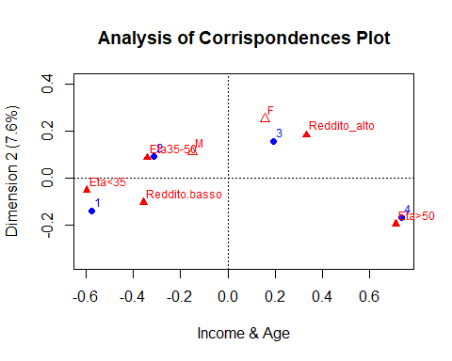
Correspondence Analysis Plot
## Categoria Price ## 31 3 1899.99 ## 15 2 1099.99 ## 14 2 1099.99 ## 3 1 329.99 ## 38 4 2799.99 ## 25 3 1899.99 ## 26 3 1299.99 ## 27 3 1299.99 ## 32 4 1999.99 ## 5 1 379.99 ## 19 2 899.99 ## 33 4 2299.99 ## 35 3 1899.99 ## 28 3 1399.99 ## 9 1 549.99

Slide 16
CONCLUSION
Metric MDS
Positioning of TV models
Dimensions Price & Screen Size
Correspondence Analysis
Relations between TV categories & buyers' characteristics Age & Income

Slide 17
THANK YOU

